Slide 1
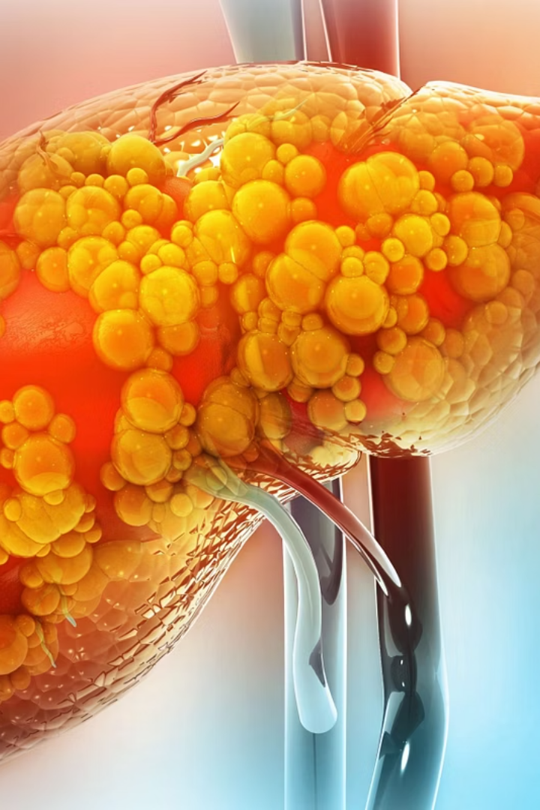

Fatty Liver
Fatty Liver is a health condition where extra fat builds up in the liver. Your liver normally has a small amount of fat, but if it gets too much, it can cause problems.
What is the Liver?
The liver is a very important organ in your body. It helps:
Clean your blood
Store energy
Help with digestion
by Ram N Java

Slide 2
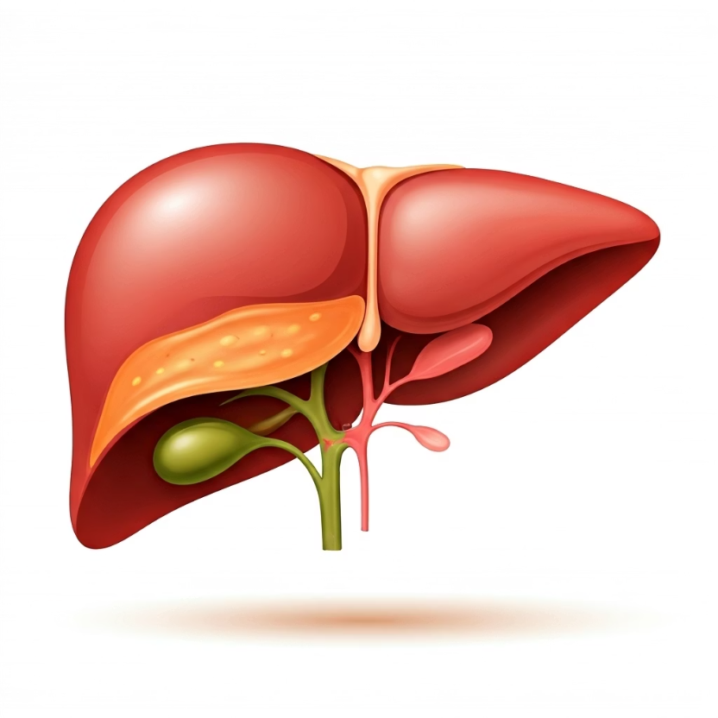
What is Fatty Liver?
Normally, the liver has some fat, which is okay. But when the amount of fat becomes too much (more than 5-10% of the liver's weight), it is called Fatty Liver.
What Happens in Fatty Liver?
When you have fatty liver, your liver stores too much fat. Over time, this fat can:
Make it hard for your liver to work properly
Cause inflammation (swelling)
Even lead to liver damage

Slide 3
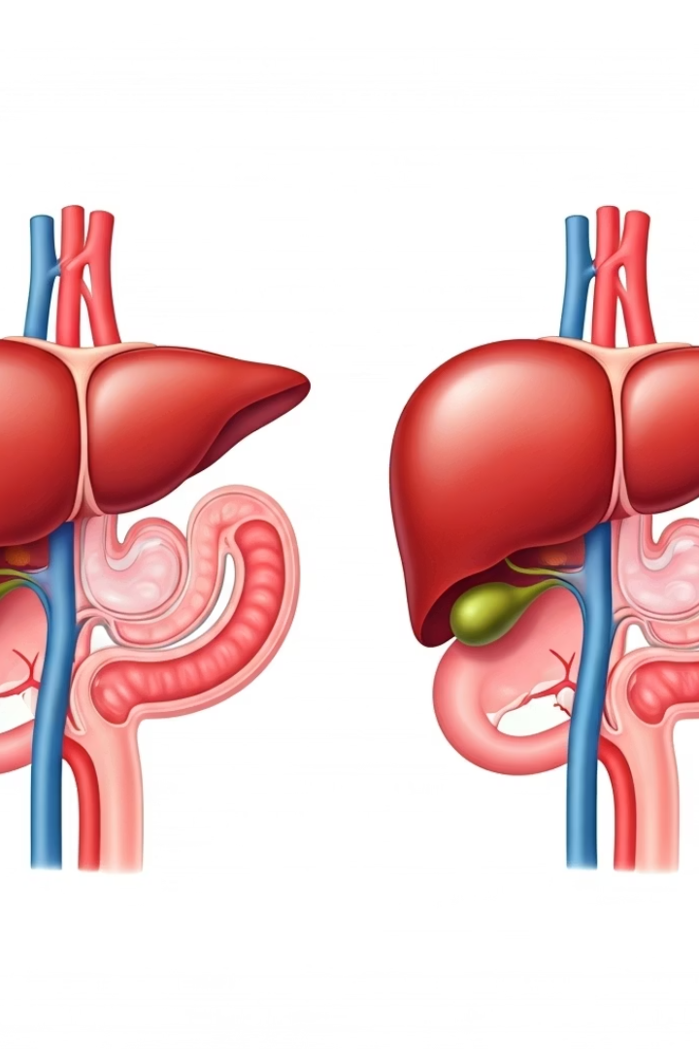
Types of Fatty Liver
Non-Alcoholic Fatty Liver Disease (NAFLD)
Happens in people who do not drink much alcohol. Often linked to:
Overweight
Unhealthy diet
Lack of exercise
Diabetes
Alcoholic Fatty Liver Disease
Happens in people who drink a lot of alcohol. Alcohol damages the liver and causes fat to build up.

Slide 4
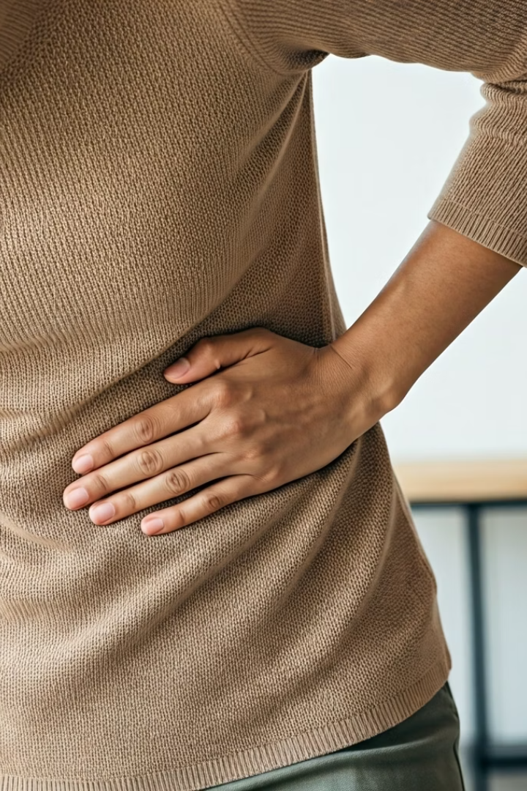



Common Symptoms
Tiredness
Feeling fatigued even after adequate rest
Pain in the upper right side of the belly
Discomfort in the area where the liver is located
Weakness
General feeling of reduced strength
Many people with fatty liver don't feel anything at first. But over time, some may experience these symptoms.
If the liver becomes more damaged, it can lead to a condition called cirrhosis, which is serious.

Slide 5





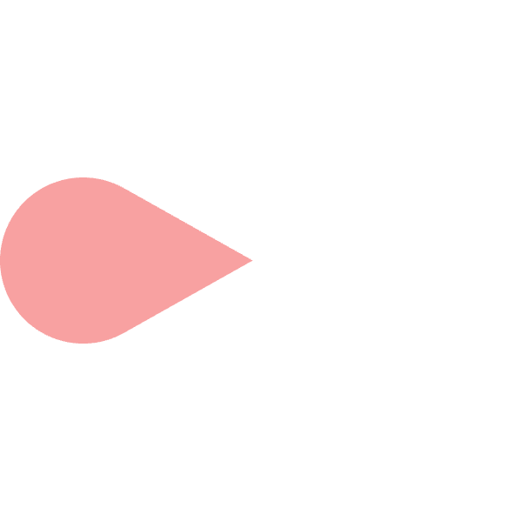






Causes
Overeating
Eating too much sugar or fat
Consuming more calories than your body needs
Diets high in processed foods and sugary drinks
Having diabetes or high cholesterol
Lack of physical activity
Sedentary lifestyle with minimal exercise
Metabolic conditions that affect fat processing
Being overweight or obese
Drinking too much alcohol
Excess body weight, especially around the abdomen
Regular excessive alcohol consumption

Slide 6










Is Fatty Liver Dangerous?
Liver Cancer
In some cases, severe fatty liver can increase risk
Liver Failure
In rare cases
Cirrhosis
Permanent liver damage
Liver inflammation
Swelling and irritation
Early Stage Fatty Liver
Not very dangerous and can be reversed
In early stages, fatty liver is not very dangerous and can be reversed. But if not taken care of, it can progress to more serious conditions as shown in the pyramid above.

Slide 7
How is it Diagnosed?
Liver biopsy
Ultrasound scan
In this procedure, a small sample of liver tissue is taken and tested. This is rare and usually only done in more complex cases.
Blood tests
This imaging test allows doctors to see fat in the liver. It's a non-invasive way to visualize the liver's condition.
Doctors check liver enzymes to see if there are signs of liver damage. Elevated liver enzymes can indicate fatty liver disease.

Slide 8






How to Treat or Prevent It
Lose weight
If you are overweight, even 5–10% of body weight can help reduce liver fat
Eat healthy
Focus on fruits, vegetables, and whole grains while reducing processed foods
Avoid sugar and junk food
Reduce consumption of foods high in added sugars and unhealthy fats
Exercise regularly
Aim for at least 30 minutes of physical activity daily
Avoid alcohol
Eliminate or significantly reduce alcohol consumption
Control blood sugar and cholesterol
Manage related health conditions through medication and lifestyle changes

Slide 9
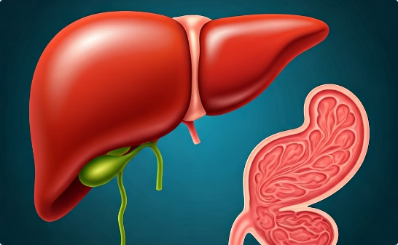
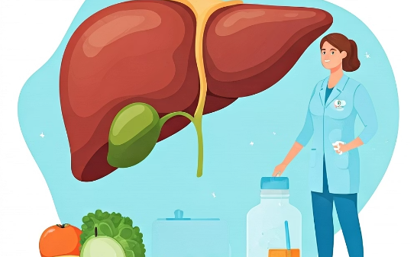
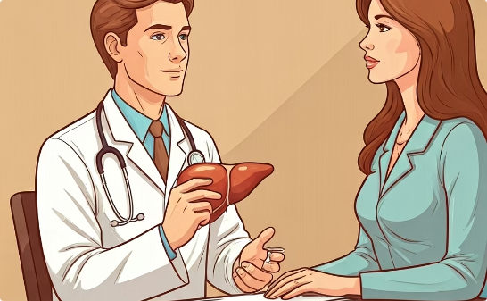
Conclusion
Reversible Condition
Healthy Lifestyle Changes
Medical Importance
Fatty liver is a condition where too much fat builds up in your liver. With proper care, it can be reversed or controlled.
Making changes to your diet, weight, and overall health can significantly improve liver health and prevent progression.
If not treated, fatty liver can lead to serious liver problems. Regular check-ups and following medical advice are essential.

